Slide 1

UAV data acquisition protocol for coastal areas:
testing and validation in the real World
Doukari M., Papakonstantinou A., Topouzelis K.

Slide 2
Introduction
Abilities of UAS has made them very popular in marine applications
UAV survey limitations in marine environment – the problem
UAV Data Acquisition Protocol – the solution
UAV toolbox – the tool

Slide 3
UAV Protocol
Parameters
Weather Forecast Data
Testing
Validation
2 Case studies
Sun position
UAV Toolbox
Categories
Comparison
Methodology

Slide 4
Methodology
Structure of
UAV Protocol
UAV Protocol Parameters
Morphology of the area | Environmental Conditions |  | Flight Planning
 | Weather conditions/ phenomena | Oceanographic parameters
Location: terrain, position | Wind Speed-Surface Waves | Turbidity | UAV parameters
Marine Information: marine habitats, bathymetry | Air Temperature | Water Temperature | Sensor Parameters
 | Clouds/Haze-Humidity | Tides | Survey plan
 | Sun position- Sun glint | Phenology
 | Rain/Snow

Slide 5
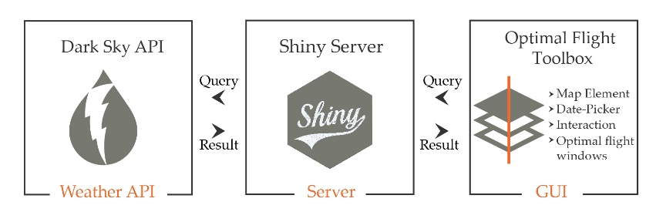
Methodology
UAV toolbox
Variable | Thresholds | Units
Wind Speed | <= 3.3 | m/s
Precipitation Probability | < 50 | %
Temperature | < 30 | Celsius
Cloud Cover | < 25 | %
Wave Height | <= 0.5 | m
Sun Angle/Elevation | >=25 <=45 | degrees

Slide 6
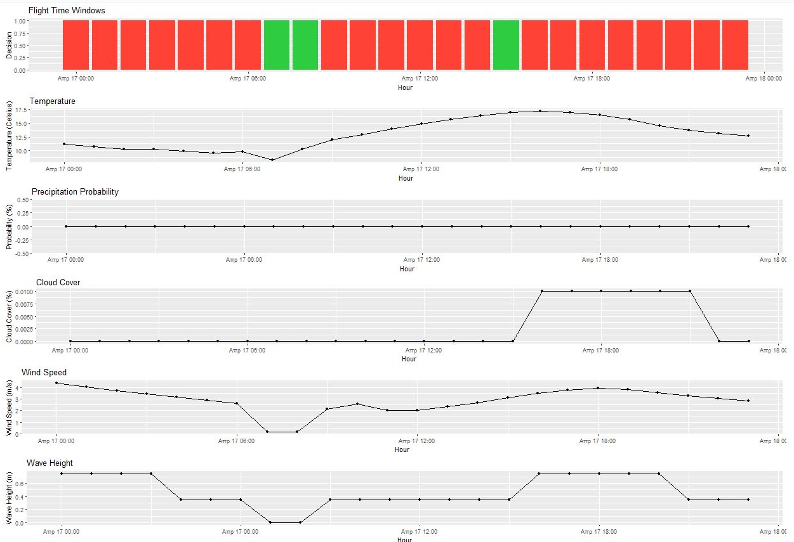
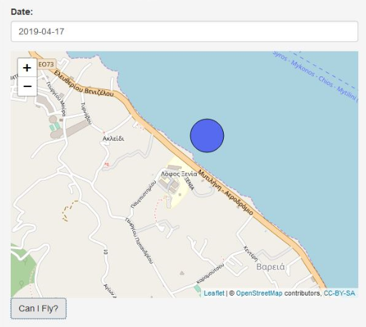
Methodology
UAV toolbox

Slide 7
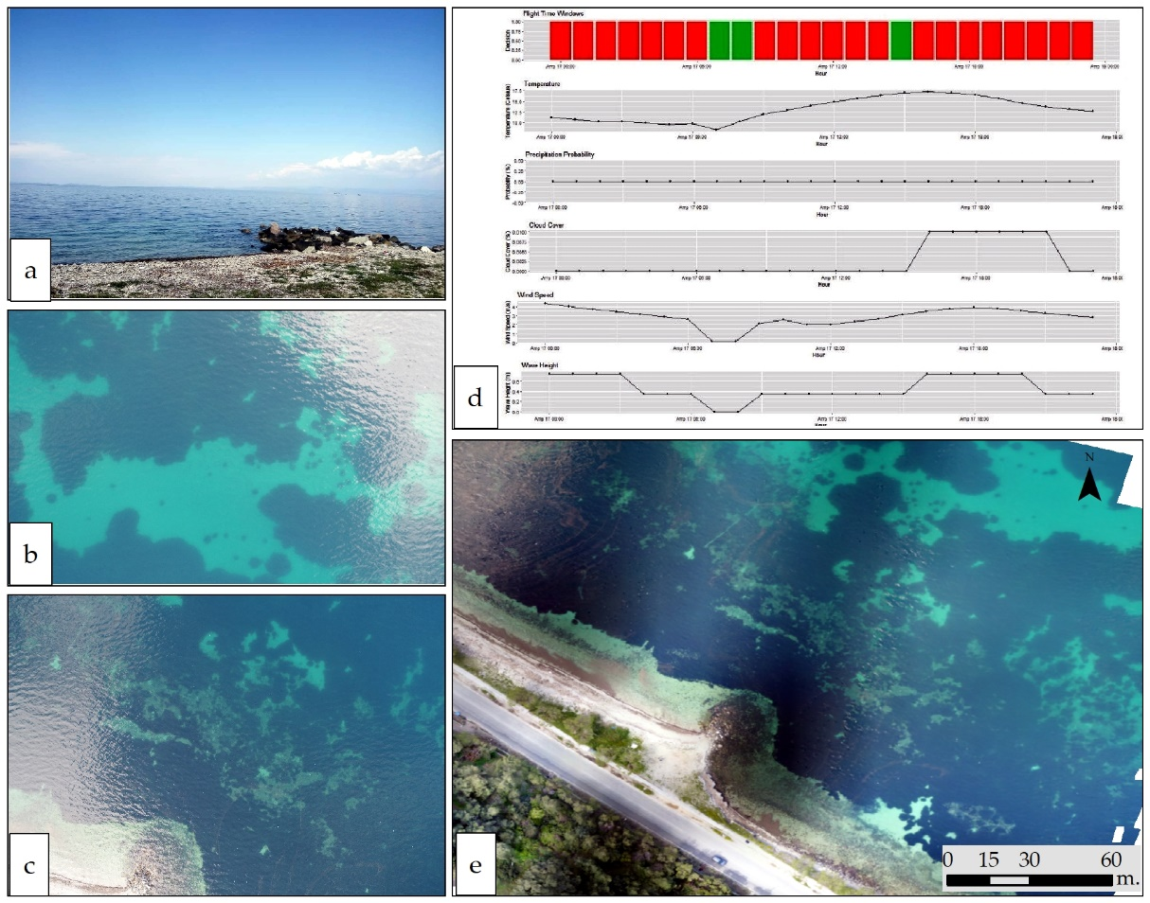
Results

Slide 8
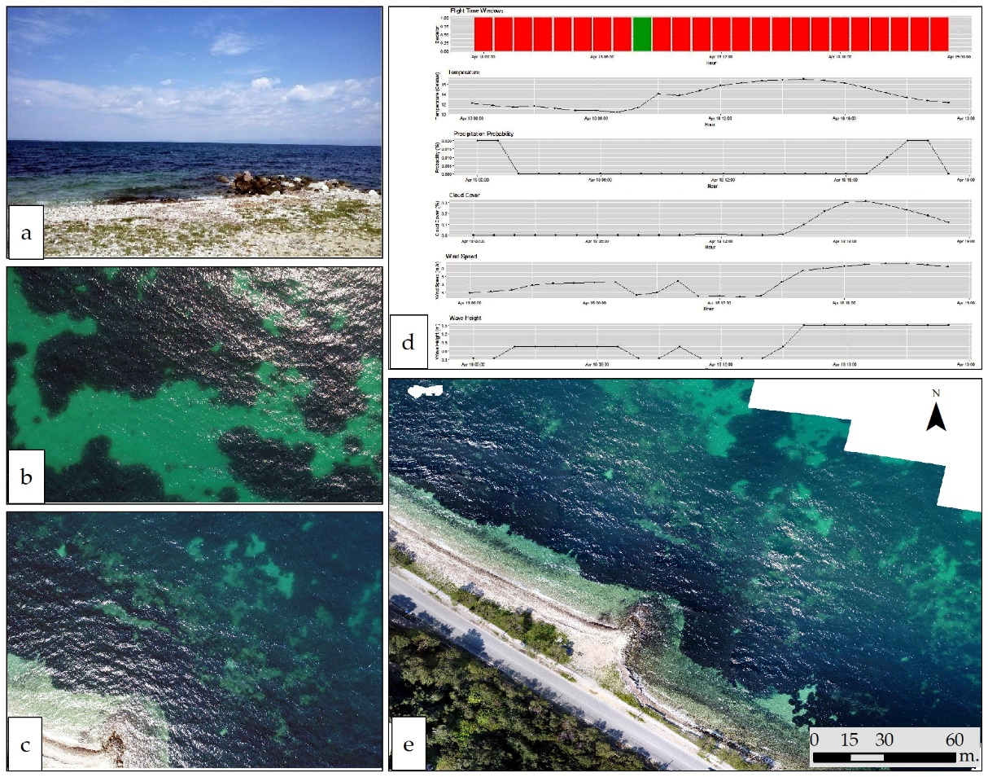
Results

Slide 9
Validation
Seagrass 48.03%
Mixed 27.88%
Sand 24.09%
OA | 94,40%
Kappa Index | 0,92
OA | 88,89%
Kappa Index | 0,83

Slide 10
Conclusions
UAV Data Acquisition protocol:
  necessary for an effective UAV survey over coastal areas
  improves the quality of the acquired data
  effective resources management (planning, flight time, equipment)
  operational methodology for marine data acquisition
UAV toolbox:
  easy to use toolbox
  improves the flight planning of a UAV survey
  results in high quality data (not available so far)
  higher accuracy on results produced on the optimal flight time window

Slide 11

Acknowledgment:
This research has been co‐financed by the European Regional Development Fund of the European Union and Greek national funds through the Operational Program Competitiveness, Entrepreneurship and Innovation, under the call RESEARCH – CREATE – INNOVATE (project code:T1EDK--04993)
Michaela Doukari
m.doukari@marine.aegean.gr

